Slide 1

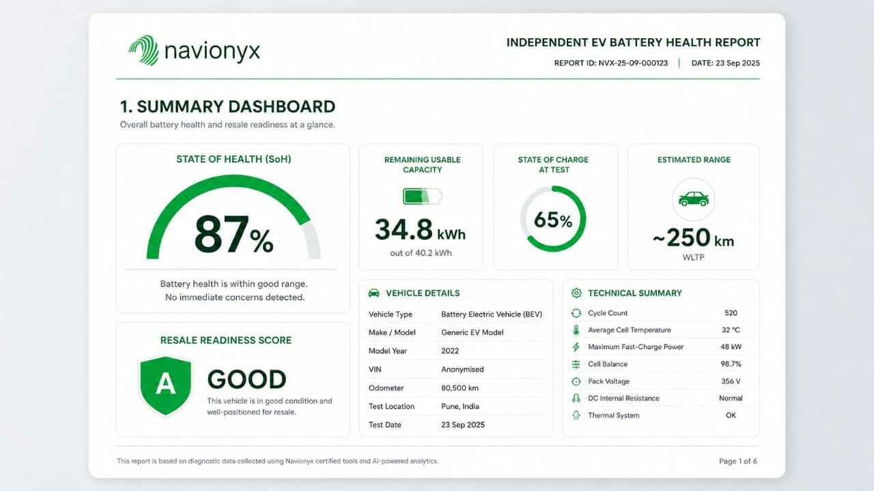
CLEANING PROPOSAL
NAME:- SREEJA SANYAL
WEEK :-2
DAY:-9
DATE:- 09.09.2026

Slide 2
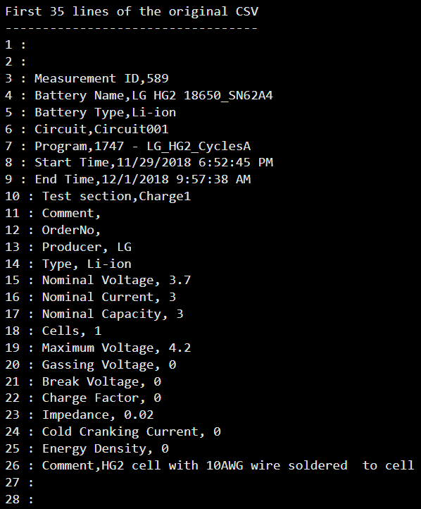
Data Quality Findings:-
The initial data-quality assessment was performed on the battery charging measurement files.
Major observations:-
Some CSV files contain metadata/header information before the actual measurement records.
Missing values were observed in different columns/files and need to be investigated before modelling.
Some files have inconsistent structures or column formats.
Numerical measurement columns need to be converted into a consistent numerical format.
Duplicate or repeated records need to be checked.
Possible abnormal values must be investigated using the physical operating range of the battery.
The data should be standardized into a common structure before machine-learning modelling.
screenshot of the original csv file of 0degC
of "589_Charge1.csv”

Slide 3
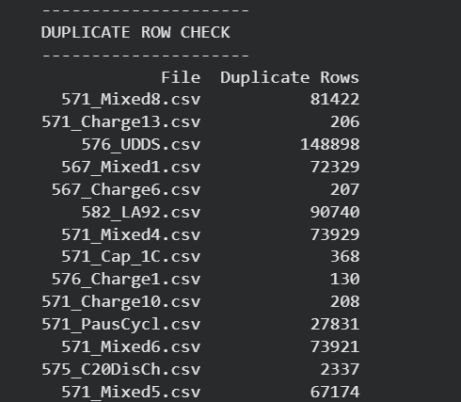
Why cleaning is required:-
Data cleaning is necessary to ensure that only valid measurement records are used for analysis and model development.
Incorrect, duplicated, incomplete or non-measurement rows can introduce bias and may negatively affect model performance.
The main variables of interest are :
Voltage
Current
Temperature
SOC
Charging-time-related measurements
Battery SOC estimation commonly uses measurable quantities such as voltage and current together with suitable algorithms.
The duplicated rows present in the dataset which can effectively hinder the performance of model.

Slide 4
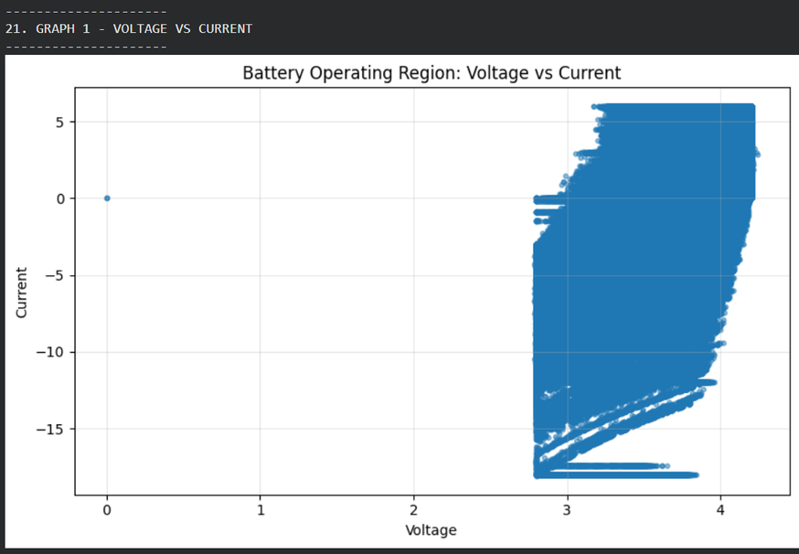
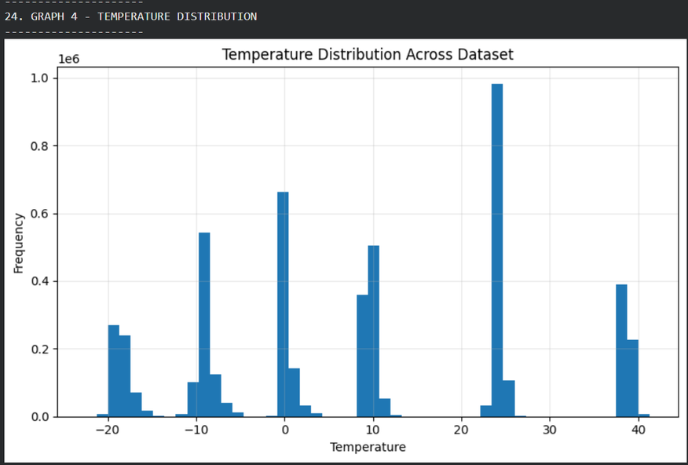
Operating Regions, Target Coverage
Operating regions to be identified
The cleaned dataset will be analysed to determine the normal operating regions of:
Battery Voltage
Charging Current
Temperature
State of Charge (SOC)
Charging/elapsed time
The distributions and relationships between these variables will be visualized to identify normal operating regions and potentially abnormal measurements.
Target regions
The two main prediction targets are:
Battery State of Charge (SOC)
Remaining Charging Time

Slide 5
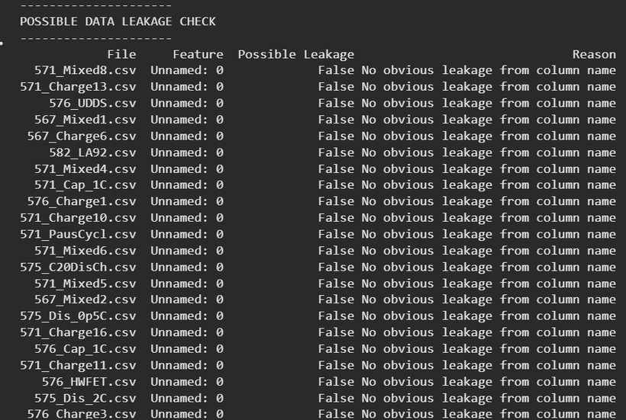
Leakage risk
Data leakage is a major concern because battery measurements are sequential and may belong to the same charging cycle/session.
Potential leakage can occur if:
Information from the future is used to predict an earlier measurement.
A target-derived variable is accidentally used as an input feature.
Measurements from the same charging cycle appear in both training and testing data.
Random row-wise splitting allows highly similar consecutive measurements to occur in both sets.
Proposed approach
Use cycle/session-aware data splitting wherever the dataset structure allows it. Features should only contain information that would realistically be available at the prediction time.
This is important because independent cycle-level testing can help prevent leakage and provide a more realistic evaluation of generalization.

Slide 6
Proposed Cleaning Plan
Cleaning requirement | Proposed action
Metadata and inconsistent columns | Remove metadata rows and standardize column names
Non-numeric values | Convert valid values and flag invalid entries
Missing values | Quantify and investigate before treatment
Duplicates | Detect and remove confirmed duplicates
Abnormal measurements | Flag values outside expected operating ranges
Target leakage | Remove future- or target-derived features
Train/test contamination | Use cycle- or session-aware splitting
Different file structures | Convert files to a common schema

Slide 7
THANK YOU!

